Slide 1

CPD Frameworks in Learning and Teaching –
Thinking Differently
Contribution to SEDA CPD Framework workshop, May 2012
Alison Nimmo
GCU LEAD (Learning Enhancement & Academic Development)
Glasgow Caledonian University

Slide 2
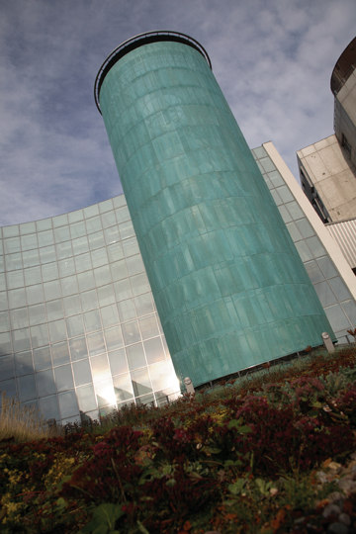
GCU LEAD (Learning Enhancement & Academic Development
Scenario 4
Aim:
to develop innovative teaching and learning within GCU and further afield.
Model:
Partnership matrix model:
  5 themes- horizontal partnership
  3 Schools – vertical partnership

Slide 3
Scenario 4
Tansformational change
Model for transformational change
Perpetual transition
management
Trigger
Vision
Conversion
Maintenance and renewal
(Bucanan and McCalmun, 1989)
external factors, trends, blue skies
thinking
future directions, strategy, innovations
diffusion of ideas, implementation,
support structures, reward
reflection, evaluation, enhancement

Slide 4

Scenario 4
Triggers
Key Information Sets (KIS)
- Heads of Dept
League Tables
- Senior Executive
International Student Barometer
- International partnerships
Quality of Student Experience
- Student Association
- QAA
HEA CPD Framework Pilot

Slide 5
Scenario 4
Tansformational change
Vision
Change at institutional
level in:
Awareness of UKPSF
Perception of teacher recognition
Level of recognised staff -
75% by 2015
Model
Build on existing Distributive Leadership principles

Slide 6

Distributive Leadership – GCU’s Definition
Develop capability for engaging in, and leading innovation in learning and teaching across all levels of the teaching community
Support a cascading model of CPD and encourage the development of reflective teachers
Leadership based on action (action research) not on job title

Slide 7

Scenario 4
Conversion
Issues
Previous attempts to integrate failed
Only new or inexperienced staff engaged with UKPSF
Potential Solution
Build in scaffolded routes to recognition for experienced staff based on familiar CPD opportunities
Create distinct support for experienced staff

Slide 8
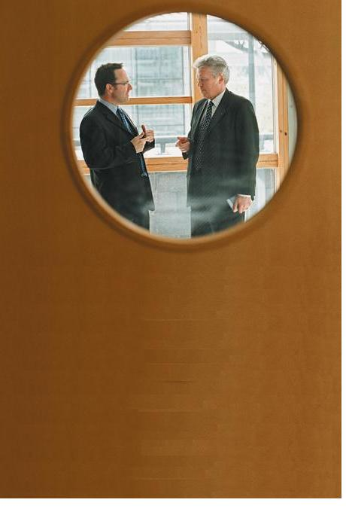
Scenario 4
Conversion
Recognition through:
Formal Taught provision
D1 – PEC
D2 - PgC
Informal CPD:
D1 – D4 Recognition Claims
New Partnership Team
Scenario 3

Slide 9

Scenario 4
Thinking differently
Step 1: Create Brand Identity
Brand Identity
AcceleRATE – Recognising Achievement in Teaching Excellence
Experienced staff only
Recognising what you’re already doing

Slide 10

Scenario 4
Thinking differently
Step 2: Update our CPD Policy and Framework in Learning and Teaching
Step 3: Refresh and integrate existing CPD provision particularly to support core knowledge and professional values dimensions
Scenario 3

Slide 11

Scenario 4
Tansformational change
Thinking differently
Refreshing:
AcceleRATE Partnership Team
Structured handbook
Top up workshops
Top up online materials
Reflective collaborative blog
E-Portfolio
R
Notes:
Support for experienced staff particularly to support CK and PVs

Slide 12
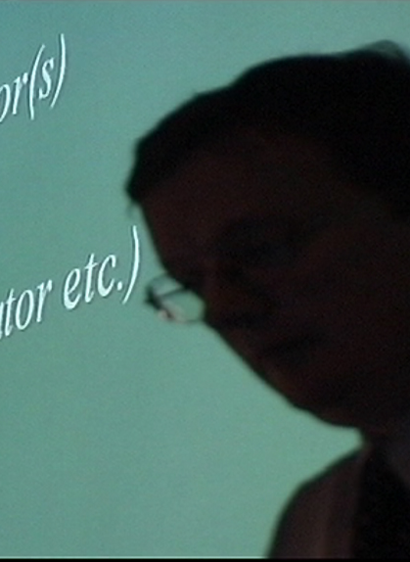
Scenario 4
Thinking differently
Step 4: Embed in HR processes
Step 5: Embed in familiar CPD practice
Scenario 3
Notes:
Map existing CPD activities
Map potential evidence
Create vignettes of real people

Slide 13
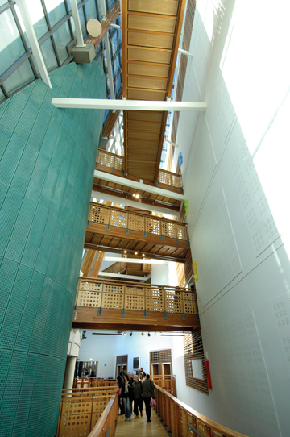
Scenario 4
GCU LEAD
Familiar practice:
PDAR
Promotion round
School based CPD
Scholars and Associates
Action research
Teaching Awards
Notes:
All revised to reflect UKPSF

Slide 14
Thinking Differently – Key Learning Points
The Framework is accredited by the HEA, not each component
The process is one of recognising eligibility for fellowship
  Either following the award of your university accredited programme or
  through presentation of a successful Recognition Claim
  Issue:
  Transparency

Slide 15
Thinking Differently – Key Learning Points
A CPD Framework encompasses
An Assessment Board to award academic credit
A Recognition Panel for e-portfolio recognition claims
A Framework Board who confirm professional recognition across D1-D4 on recommendations of above Board and Panel

Slide 16
Thinking Differently – Key Learning Points
Need to revise current credit bearing programmes now for re-accreditation (even if not due until 2013)
All provision is accredited once through the CPD Framework accreditation process
All credit bearing programmes into captured in the one Framework
Issue?
Can all formal taught CPD provision be updated and integrated where not centrally delivered

Slide 17
Vision
Extending reputation
Thinking differently – key learning points for me
  UKPSF is focussed on activity and practice
  Not on roles
  Consider the term ‘category’ of fellowship and not levels to avoid implying hierarchy
  Issue?
  How communicate to ‘senior’ staff that they will not automatically qualify for PF
Notes:
Need to produce some vignettes

Slide 18

Thinking differently - Key learning points for me
Presentation of evidence
Volume of evidence
Issue:
Tension between written presentation and oral presentation of evidence
Notes:
No need to follow the terminology or word count or indeed the format demanded by the HEA if applying through the individual route.
Staff willingness to write lots or indeed at all
Tension between professional dialogue route and needing evidence of academic writing ability

Slide 19
Thinking differently – key learning points for me
Nature of a PF recognition claim
Is qualitatively different
Issue?
How know what evidence expected when no PFs in own institution
Notes:
Some of our staff will go through the individual recognition route

Slide 20
Scenario 4
Tansformational change
Thinking differently – Key Learning Points
Externality of the process
HEA accreditor
External accreditor
Sustainability of the process
Consortia approaches
Non competitive
Issue?
Volume overload for HEA
Appeals procedure
Turning down claims from ‘senior’ staff
Notes:
Use a third university?

Slide 21
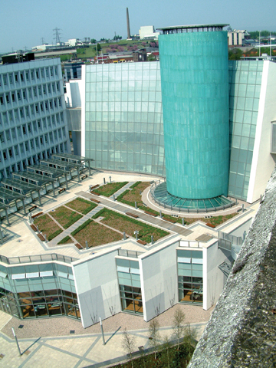
Scenario 4
Maintenance and Renewal
Re-accreditation every three years
Need to get accredited first!

Slide 22
CPD Frameworks in Learning and Teaching –
Thinking Differently
Contribution to SEDA CPD Framework workshop, May 2012
Alison Nimmo
GCU LEAD (Learning Enhancement & Academic Development)
Glasgow Caledonian University

