Slide 1
Putting internationalisation into practice: how to inform and develop your teaching. SEDA Spring Conference 14th – 15th May 2015
Angela Hammond
University of Hertfordshire

Slide 2
Discussion session
Some principles and practices in relation to internationalising the curriculum
Consideration of a resource to support academics in delivering an internationalised curriculum.
Findings from research into its use
Notes:
Aims, how I hope it will be useful
A resource that is om open access

Slide 3
Curriculum Design Toolkit
Diagnosing practice
Underlying pedagogic principles
Features and consequences
Ideas for development
Good Practice in Higher Education
Enterprise
Sustainability
Research Informed Teaching
Employability
Inclusive Teaching
International Engagement
Assessment for Learning
The toolkits were developed between 2008 and 2011 by a team of staff in the Learning and Teaching Institute at the University. Credit in particular to Mark Russell and Helen Barefoot.
Notes:
8 strands, developed by a team of people
Links to the literature and the pedagogy
Key aspects of learning teaching and assessment
Key priorities for the organisation
Latest strategic plan: ‘Strengthening the global perspective in the curriculum’
UH graduate attributes - Intellectual depth, breadth and adaptability – ‘multiple perspectives’; Respect for others ‘cultural awareness……………..inclusive and able to work in a wide range of cultural settings’

Slide 4
The international practitioner in H.E…
5. Ensures personal staff development includes internationalisation aspects.
4. Uses a range of support mechanisms that take account of cultural diversity.
1. Provides a curriculum that demonstrates how the discipline is represented in different cultures.
2. Responds to students’ diverse learning experiences.
3. Promotes social and cultural integration.
Notes:
These are the over-arching principles for the internationalisation strand
Notion of curriculum is central; enabling students to develop a global perspective, along with social aspects of learning and support; finally own professional development (UH strategic plan rewarding excellence)

Slide 5
Good practice in International Engagement
1. Provides a curriculum that demonstrates how the discipline is represented in different cultures
1.1. Using global examples I present the historical and cultural context of my discipline.
1.5. I encourage my students to take advantage of opportunities for visits, placements or exchanges overseas.
1.4. I am alert to opportunities where my teaching can be enriched by influences from other cultures and use international contacts and networks to enable this.
1.3. I address norms and values from different cultures and recognise other-cultural viewpoints.
1.2. In my teaching, I compare and contrast how the discipline is considered in different cultures.
Notes:
Fist principle: cultural issues within the curriculum (so curriculum design; need to draw upon a wider perspective to avoid bias; respect and recognition of alternatives; drawing on networks; exchange and visits
All other princi0plues take a similar approach

Slide 6
Use of the toolkit
At individual, module or programme level
Assignment on the Postgraduate Certificate in Learning and Teaching in Higher Education
2000 words:
Diagnosis and results
Analysis of curriculum design
Critical reflection on practice
Notes:
How we use it in the university. Built into validation (Periodic review handbook have to say how have been used) Internal reference point:
Students should develop a global perspective and the ability to work in a variety of cultural settings
In order for students to develop a global perspective and work in a variety of cultural settings, there are three main areas for consideration:
Teachers should ensure that they take opportunities, as appropriate, to locate curriculum content within its global context
Teachers should take steps to understand their students’ cultural backgrounds; and ensure their teaching methods value cultural differences and facilitate cultural integration, as appropriate, in class
Support arrangements should ensure that all students are able to thrive within the learning, teaching and assessment environment of the programme
In addition, staff and student exchange opportunities should be encouraged, as practicable.
Further guidance is available at: (link to the LTI Knowledge Exchange)

Slide 7
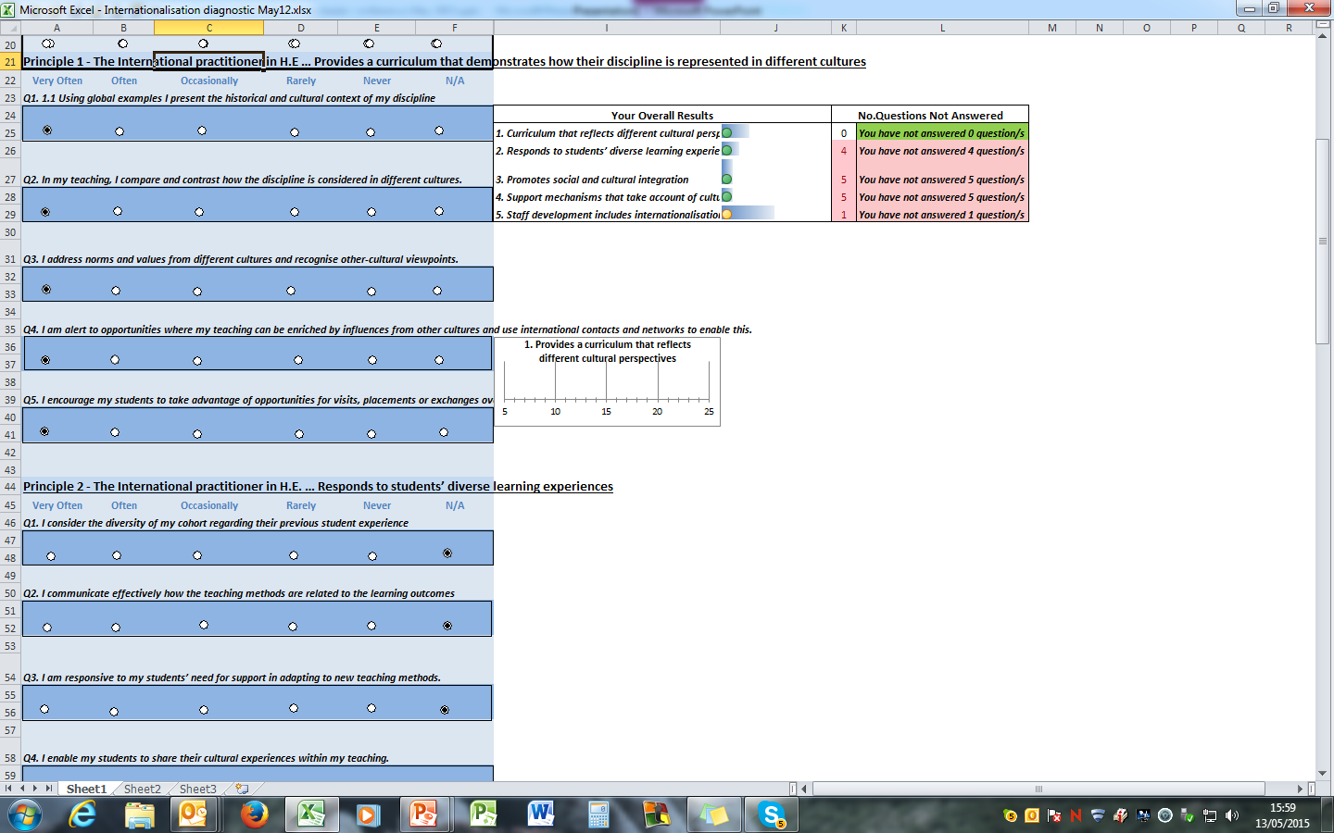
An example of the diagnostic tool

Slide 8
Analysis of scripts
20 scripts
Analysis within the context of our own evaluation and development of the curriculum
All findings anonymised
Key themes emerged
Notes:
Reflective practitioner protocol re: ethics
Our External says it helps people to challenge their assumptions
Major themes that link across practice

Slide 9
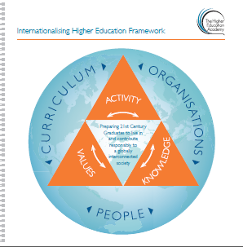
Key themes from the scripts
Analysis of practice:
assumptions; strengths and weaknesses; contribution to the curriculum; professional development
Consideration of change:
how to adapt; action plans; classroom dynamics; fostering discussion with students
Consideration of the curriculum:
opportunities for internationalisation; perspectives and viewpoints; disciplinary differences
The wider perspective:
pedagogy; relevant literature; external influences; professional bodies
Maps to the HEA
Internationalising Higher Education Framework
(Curriculum; Organisations; People)
and to the UK Professional Standards Framework
(Areas of Activity; Core Knowledge; Professional Values)
Notes:
Themes and what they threw up; areas where no comments and need to explore further - if not why not)
E.g. how contribute to the curriculum on an individual basis; difficulty of implementing internationalised curriculum.

Slide 10
To access the toolkit
Through Prezi to gain an overview
Through the LTI Knowledge Exchange to use as a diagnostic tool
Excel spreadsheets –traffic light system for results
Supporting material as Word documents
Notes:
How to use it and what to do with the results: e.g. action planning; e.g. module evaluation; e.g. professional development; e.g. international networks

Slide 11
Choose one of the 5 principles to reflect on
Promotes social and cultural integration
Responds to students’ diverse learning experiences
Provides a curriculum that demonstrates how the discipline is represented in different cultures
Ensures personal staff development includes internationalisation aspects
Uses a range of support mechanisms that take account of cultural diversity
In what ways do you foster a global perspective in the classroom?
Do you provide opportunities to talk about previous learning experiences?
What steps do you take to promote social and cultural integration?
Do you encourage international students to use language support?
How does your own staff development take account of internationalisation?
Notes:
10 minutes for discussion

Slide 12
Thank you for listening
Any questions?
Any thoughts?
Any comments?
Any suggestions?
Notes:
Reflective practitioner protocol re: ethics
Our External says it helps people to challenge their assumptions
Major themes that link across practice

